Slide 1
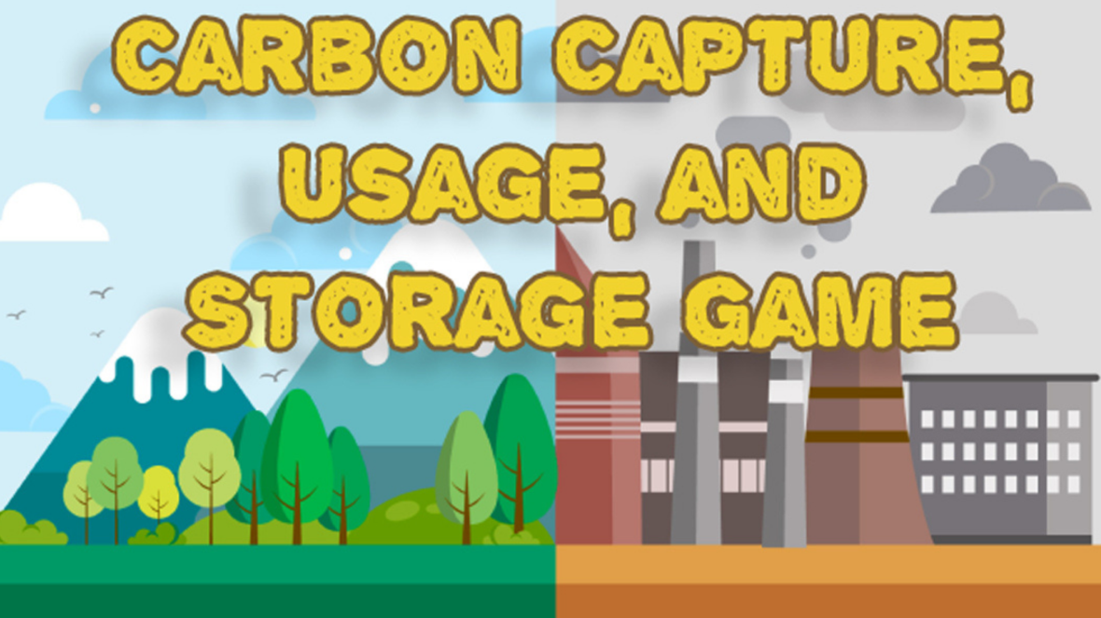

Computer Simulation & Gaming (CSG) Student Development Project

Slide 2
Project Summary
The Untitled CCUS Project is an educational simulation game designed to teach players about carbon emissions and climate change solutions through engaging gameplay.
Developed by Computer Simulation & Gaming (CSG) majors at the University of Tulsa, this game aims to raise awareness and inspiring sustainable action, all within a quick, impactful learning module.

Slide 3
Untitled CCUS Game
Will you rise to the challenge, or will history repeat itself?
The fate of the city—and the planet—is in your hands.
Strategize, manage, and transform to build a sustainable future or face the consequences.
“

Slide 4
Goals
📌 Engage & Educate Transform complex concepts of CCUS into an interactive and immersive gameplay experience.
👥 Engaging for All Educational content is designed for young learners, with intuitive mechanics that appeal to a broader audience.
🌍 Real-World Impact Empower players to strategize real-world CCUS solutions fostering critical thinking and awareness of climate challenges.
🚀 Sustainable Futures Inspire players to reflect on their own communities and develop better habits for building a more sustainable future.

Slide 5
Educational Value
🌍 Learn about CCUS Technologies: Introduces children to current and future carbon capture solutions and their potential impact on the environment.
⚖️ Understand the Balance: Explores the trade-offs between sustainability, cost, and community happiness, showing real-world decision-making.
💡 See the Consequences: Demonstrates the effects of carbon emissions and the importance of reducing emissions for a sustainable future.
🌱 Supports UN Sustainability Goals: Targets Goal 13 (Climate Action) and Goal 11 (Sustainable Cities and Communities) by empowering players to develop sustainable strategies for the future.

Slide 6
UN sustainable development goals
🌍 SDG 13: Climate Action
Focus on reducing carbon emissions through CCUS technologies.
Highlight the urgency of climate action to foster awareness of climate change.
🏙️ SDG 11: Sustainable Cities and Communities
Emphasizes building resilient communities with a focus on environmental sustainability.
Highlights the balance between urban growth, quality of life, and reducing environmental impact.

Slide 7
Narrative
To prevent a climate disaster, the player assumes the role of a Time Traveler.
As City Manager, they must implement carbon capture solutions while balancing community happiness.
With just 20 minutes to shape 20 years, every decision counts.
Will the player rise to the challenge, or will history repeat itself?
The fate of the city—and the planet—is in their hands. Build a sustainable future or face the consequences.

Slide 8
GAmeplay
🏙️ Manage carbon emissions, budgets, and community happiness in a city-building simulation.
⚖️ Balance economic growth with environmental responsibility, making decisions that have real-time consequences.
🚧 Tough choices like building roads (increasing emissions) versus implementing CCUS solutions or planting trees (with a cost).
😊 Community happiness directly impacts the budget, enabling or restricting carbon capture solutions.
📚 Introduces players to CCUS strategies, providing players with the tools to learn about sustainability.
⏱️ 20-minute playthrough designed for quick, impactful learning on balancing growth and sustainability.

Slide 9
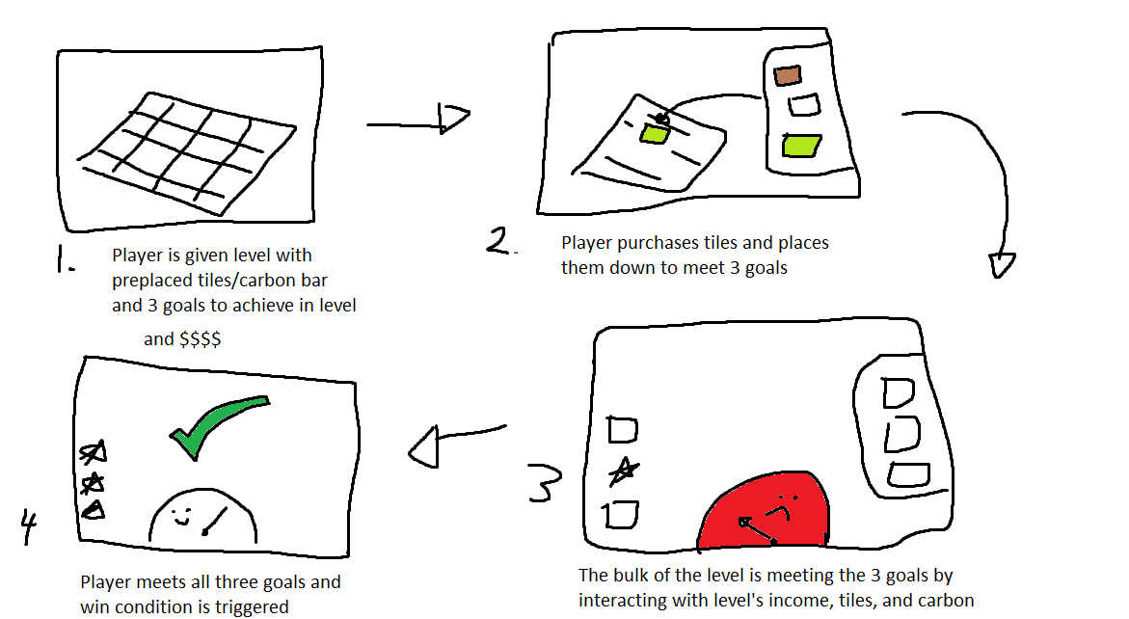
Gameplay Loop

Slide 10
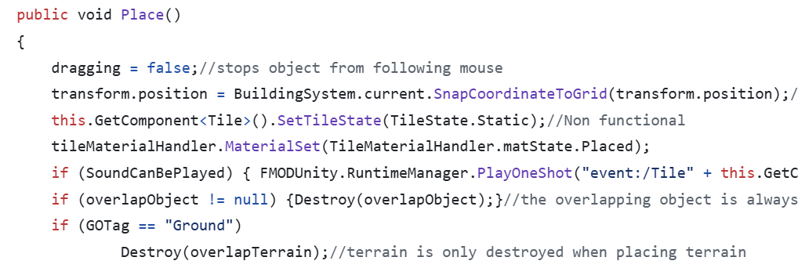
Current Development
✅ City-building mechanics: Focus on balancing emissions, budget, happiness, and time.
✅ Emissions, budget, and happiness system: Players can track and manage these key elements in real-time.
✅ Time Traveler narrative: Completed the storyline structure, focusing on climate disaster prevention.
✅ Educational Goals Defined
Initial research on CCUS technologies and their real-world applications.
Defined educational objectives for integration.

Slide 11
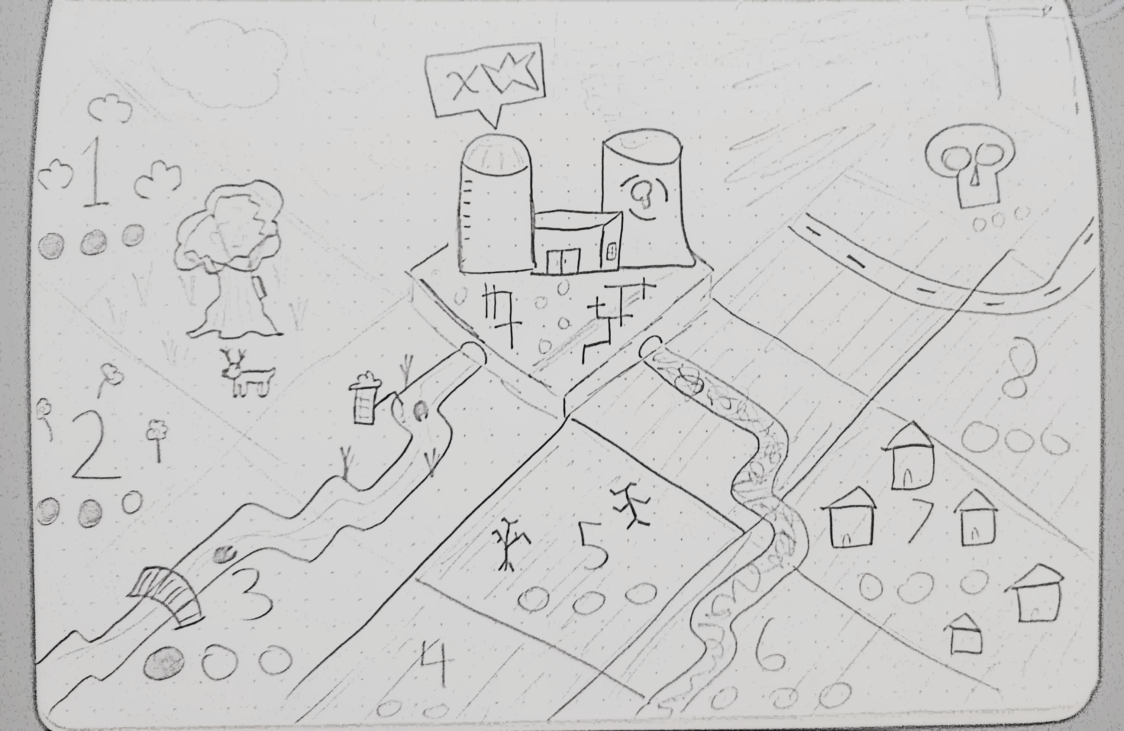
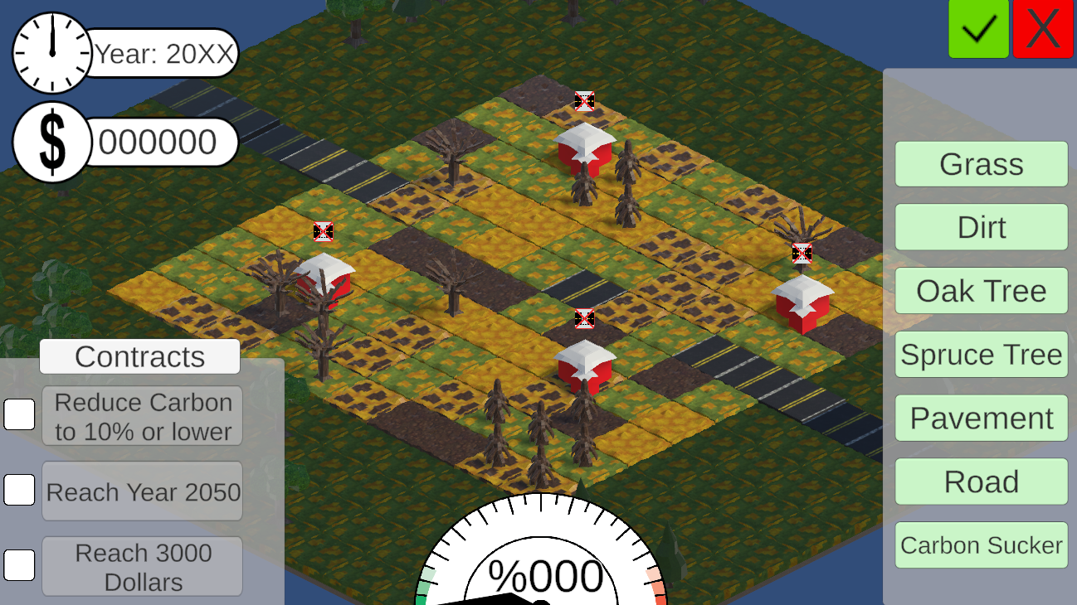
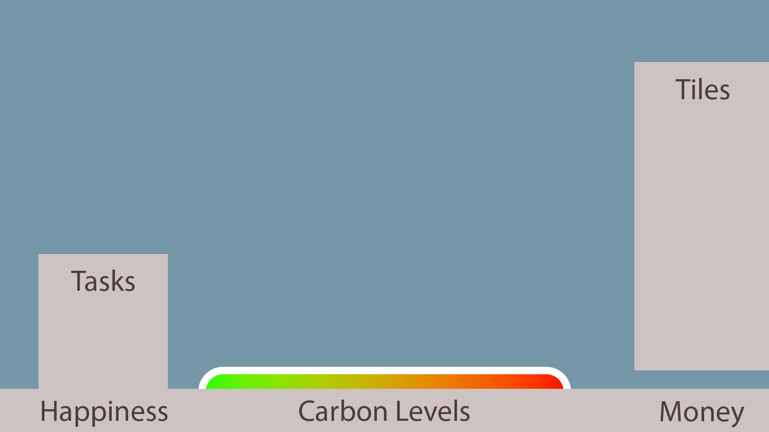
Concept to Prototype
Map Concept
Playable Prototype
UI Mockup

Slide 12

Gameplay trailer
https://drive.google.com/file/d/1eumeoiWPMIuRuIr5ZdDG_t6GimglS8OM/view?usp=drive_link

Slide 13
Next Phase
🔧 Refining the User Interface (UI)
Improve layout, accessibility, and overall user experience by making menus intuitive and information easy to navigate.
🎓 Develop Tutorial & Onboarding
Create a tutorial to guide players through mechanics and introduce key concepts and feels like a natural part of the gameplay.
🎬 Add Animations & Interactivity
Expand animations and interactive elements to deepen engagement and reinforce key gameplay moments.
📚 Integrate Educational Content
Implement audio and text-based educational content to teach players about CCUS within the game.

Slide 14
Project Challenges
💻 Hardware Access: Many student volunteers lack personal hardware with sufficient specs for Unity development, and available lab equipment isn't dedicated to student research projects.
⏳ Volunteer Commitment: As a volunteer project, it struggles with prioritization, leading to inconsistent availability and slower progress from students.
💸Limited Funds: Lack of available funds for purchasing tools, licenses & resources to enhance the game features.

Slide 15
💵Budgetary Needs
FUNDING CATEGORY | AMOUNT | DESCRIPTION
Research PCs for Development | $50,000 | Purchase 10 dedicated PCs with necessary specs for game development and research.
Student Compensation | $15,000 | Provide stipends to student volunteers to ensure consistent project dedication.
Development Costs | $10,000 | Fund additional software, tools, and resources needed for refining the game.
💰 Total Requested: $75,000

Slide 16
Project Team
Akram Taghavi-Burris - Faculty mentor
Blaine Grimes - Game Designer / 3D Modeler
Ava Boswell – 3D Artist
Zach Hickman - Developer
Brooks Mueller – Level Designer
Chase Mullens – Narrative Design
Ayden Pingleton – UX Designer
Christoper Depalma – 2D Artist
Aidan Pohl - Developer
Haiying Zeng - Sound Designer & Composer

Slide 17
Thank You
For more information about our project and our on-going development please visit the links below:
CCUS Project - GitHub
CCUS Project on Itch.io
For additional details please contact
Akram Taghavi-Burris (akram-burris@utulsa.edu)

